Slide 1

LDPC for 5G NR
CT-216 INTRODUCTION TO COMMUNICATION SYSTEMS
GROUP 25
Professor: Yash Vasavada

Slide 2
Team Members
Bhagya Majithiya 202301269
Ashka Pathak 202301270
Dhruv Jain 202301272
Jill Chhagnani 202301273
Vansh Vaishnani 202301274
Jevik Rakholiya 202301276
Rujal Jiyani 202301277
Dushyant Varshney 202301278
Kathan Balar 202301279
Lingampalli Venkata 202301280

Slide 3
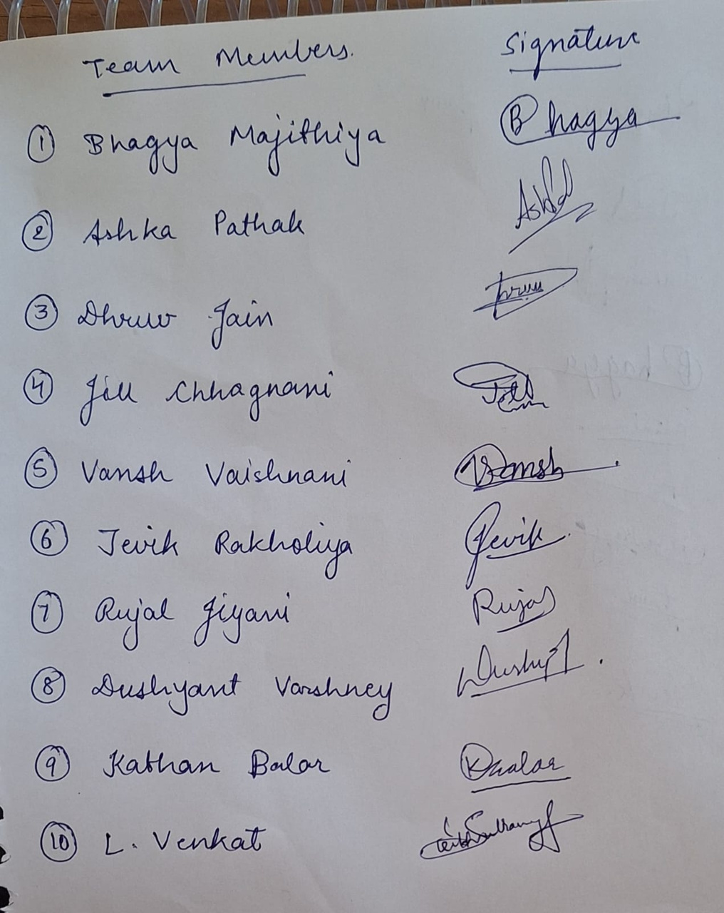

Slide 4
Honor Code
We declare that:
→ The work that we are presenting is our own work.
→ We have not copied the work (the code, the results, etc.) that someone else has done.
→ Concepts, understanding and insights we will be describing are our own.
→ We make this pledge truthfully. We know that violation of this solemn pledge can carry grave consequences

Slide 5

CT PROJECT | GROUP 25
PAGE 05
IMPLEMENTING LOW DENSITY PARITY CHECK FOR 5G
This presentation explores the implementation of Low Density Parity Check (LDPC) codes for 5G networks, highlighting their advantages and the optimization strategies employed for optimal performance in high-speed wireless communication.

Slide 6

CT PROJECT | GROUP 25
PAGE 06
THE EVOLUTION OF 5G NETWORK
The current era of technology is defined by rapid advancements that merge physical and digital realms. Technology enables greater efficiency, accessibility, and connectivity.
5G: THE NEW GENERATION
01
5G promises to revolutionize mobile communication. The demand for higher data rates, lower latency, and massive connectivity for IoT devices necessitate efficient channel coding.
CHALLENGES OF 5G
02
5G channels are complex and prone to noise and interference, posing challenges for reliable data transmission. Efficient error correction codes are crucial to ensure data integrity.

Slide 7
CT PROJECT | GROUP 25
PAGE 07
LDPC CODES: A POWERFUL TOOL FOR 5G NETWORK
Low-Density: The parity-check matrix (used to check for errors) is sparse — it contains mostly zeros and only a few ones.
Parity-Check: It's a way of checking if a block of data has been corrupted during transmission, using linear algebra.
LDPC (Low-Density Parity-Check) codes are a class of linear block error-correcting codes known for their excellent performance close to the Shannon limit, especially in high-throughout communication systems.
LDPC codes are widely used in modern standards like 5G , Wi-Fi due to their strong error-correcting capability and scalability.
They are represented by sparse parity-check matrices and decoded using iterative message passing algorithms on their corresponding Tanner graphs, allowing efficient error correction
LDPC codes are powerful error-correction codes that
achieve near-Shannon limit performance, meaning
they can effectively combat noise and interference.

Slide 8

CT PROJECT | GROUP 25
PAGE 08
MODEL OF LDPC 5G NR
MESSAGE
BITS
LDPC
ENCODER
MODULATOR
NOISE (AWGN)
DECODED MESSAGE
LDPC
DECODER
DEMODULATOR

Slide 9
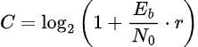
CT PROJECT | GROUP 25
PAGE 09
SHANNON LIMIT
The Shannon Limit (also called the Shannon Capacity or Shannon Bound) is a fundamental result in information theory that defines the maximum rate at which information can be transmitted over a noisy channel with arbitrarily low probability of error.
Shannon Limit / Shannon Capacity (C) for BSC(p):
Shannon Limit / Shannon Capacity (C) for AWGN per unit bandwidth:
bits/sec/hertz

Slide 10
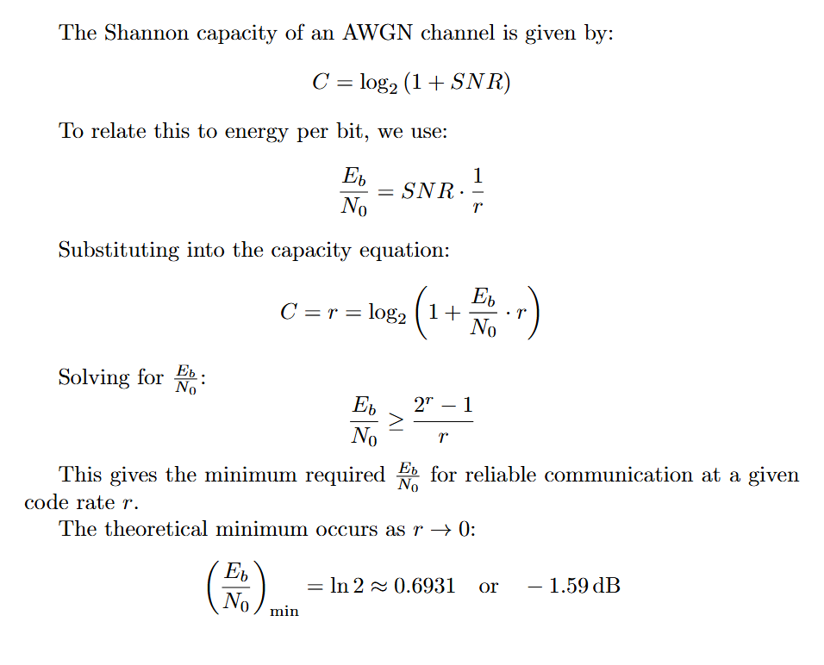
CT PROJECT | GROUP 25
PAGE 10
According to the Shannon limit:
Eb / N0 for code rates [1/4, 1/3, 1/2, 3/5] should be greater than:
[-1.2100, -1.0804, -0.8175, -0.6574]
Eb / N0 for code rates [1/3, 1/2, 3/5, 4/5] should be greater than:
[ -1.0804, -0.8175, -0.6574, -0.3321]

Slide 11
ENCODING

Slide 12
CT PROJECT | GROUP 25
PAGE 12
ENCODING IN LDPC
Encoding converts message bits into a codeword by adding redundant parity bits using a parity-check matrix. This allows for reliable error detection and correction at the receiver.
LDPC Encoder receives the message bits as an input vector m = [m1, m2, ..., mk], while the sparse parity check matrix (H) is built using the base graph and lifting factor Z.
To generate the parity bits p = [p1, p2, ... pn-k], the structure of the base matrix is exploited.The LDPC base matrix is designed in such a way that most parity bits can be calculated sequentially using simple linear equations. This is possible because of the matrix’s double-diagonal, which simplifies solving for parity bits.

Slide 13
CT PROJECT | GROUP 25
PAGE 13
Base Graphs in 5G NR (New Radio)
5G NR makes use of two different sized base graphs:
BG1: NR_1_5_352 (optimized for large block sizes). It has a size of 46 x 68.
BG2: NR_2_6_52 (optimized for small block sizes). It has a size of 42 x 52.
Base graphs are sparse matrices with integers or -1 indicating shifts or zero blocks.
Expansion Factor : Base matrix has elements like 0, -1 and any number between 0 to Z-1, where Z is an expansion factor
Each element B​i,j in the base graph defines a z × z submatrix:
Bi,j = −1 ⇒ Bi,j = zero submatrix.
Bi,j = 0 ⇒ Bi,j = identity submatrix.
Bi,j = p ⇒ Bi,j = circularly shifted identity matrix by p positions.

Slide 14
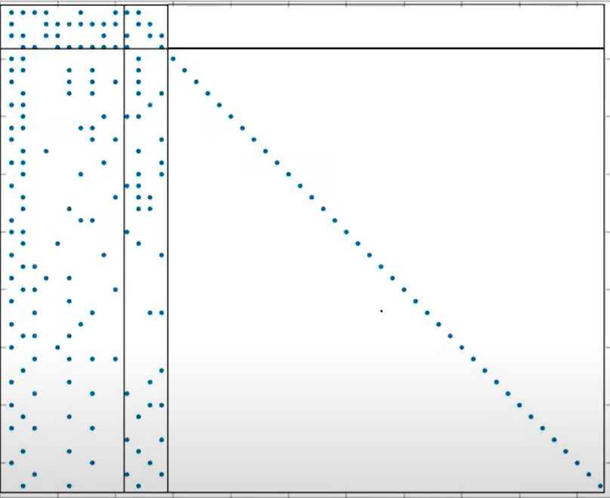
CT PROJECT | GROUP 25
PAGE 14
Structure of Base Graph
Block Structure of Base Matrix:
A E O
B C I
BG1:
A: 4 x 22 E: 4 x 4 O: 4 x 42 all zero
B: 42 x 22 C: 42 x 4 I: 42 x 42 all identity
BG2:
A: 4 x 10 E: 4 x 4 O: 4 x 38 all zero
B: 38 x 10 C: 38 x 4 I: 38 x 38 all identity

Slide 15
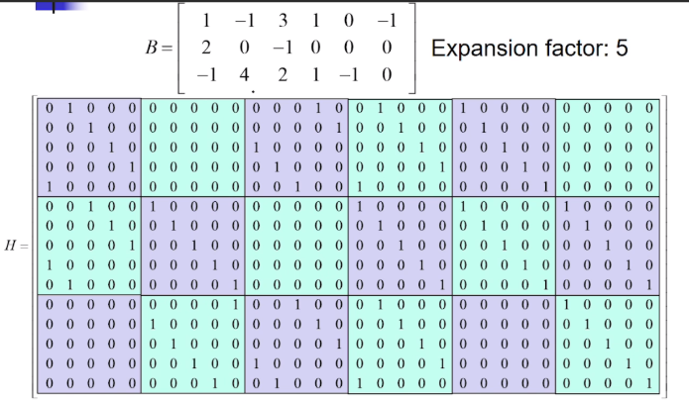
CT PROJECT | GROUP 25
PAGE 15
Conversion to H Matrix

Slide 16

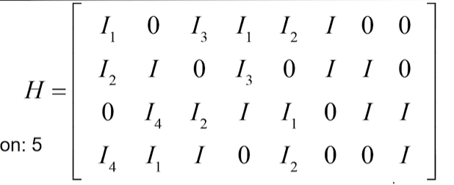
CT PROJECT | GROUP 25
PAGE 16
Encoding using Base Matrix
To perform encoding, we take advantage of the structure present in the base matrix. The key idea is that due to this specific structure, most of the parity bits (those numbered 5 and above) can be determined by solving simple linear equations.
However, for the first four parity bits, we need to solve a system of four linear equations simultaneously. The process is simplified because the matrix has a special double-diagonal form.
Let’s walk through an example to better understand the encoding steps:

Slide 17
CT PROJECT | GROUP 25
PAGE 17
Encoding using Base Matrix
We begin with message vector: m = [m₁, m₂, m₃, m₄]
We add 4 parity bits: [p₁, p₂, p₃, p₄]
So, the full codeword becomes: [m₁, m₂, m₃, m₄, p₁, p₂, p₃, p₄]
Let’s assume that the base matrix corresponds to the following parity-check equations:
Equation 1: I₁m₁ + I₃m3 + Im₄ + I2p1 + Ip2 = 0
Equation 2: I2m₁ + Im₂ + I3m3 + Ip2 + Ip3 = 0
Equation 3: I4m₂ + I2m₃ + Im4 + I1p1 + Ip3 + Ip4 = 0
Equation 4: I4m1 + I1m2 + Im3 + I2p1 + Ip4 = 0

Slide 18
CT PROJECT | GROUP 25
PAGE 18
Encoding using Base Matrix
Now, adding all four equations, we isolate one of the parity bits (say v₅, which is p₁):
I₁p1 = I1m1 + I3m3 + I1m4 + I2m1 + I2m2 + I3m3 + I4m2 + I2m3 + I4m1 + I1m2 + Im3
Substituting the known message bits in place of v₁ to v₄:
I₁p₁ = I₁m₁ + I₃m₁ + I₄m₁ + I₂m₂ + I₃m₂ + I₁m₂ + I₂m₃ + I₄m₃ + Im₄ + I₁m₄
This gives us p₁. Once we know p₁, we substitute it into Equation 1 to solve for p₂, and continue using the remaining equations to get p₃ and p₄.
The final encoded vector [m₁, m₂, m₃, m₄, p₁, p₂, p₃, p₄] must satisfy: H × c = 0, where H is the parity-check matrix, and c is the codeword vector.

Slide 19
MODULATION

Slide 20
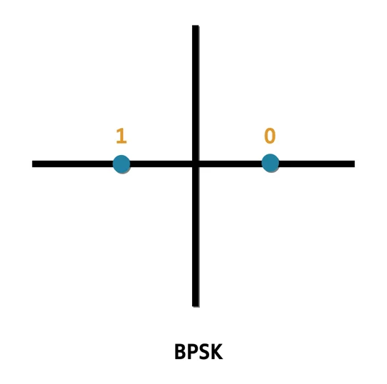
CT PROJECT | GROUP 25
PAGE 20
BPSK MODULATOR
BPSK stands for Binary Phase Shift Keying. It is a digital modulation scheme used in telecommunication.
In this scheme, binary data is modulated onto a carrier signal by changing its phase.
The carrier signal's phase is shifted by 180 degrees to represent binary transitions
It transmits only one bit per symbol, which limits the data rate but improves noise immunity.
Before modulation, the encoded output is passed to the BPSK modulator, which maps the binary bits to symbols:
1 → -1
0 → 1

Slide 21
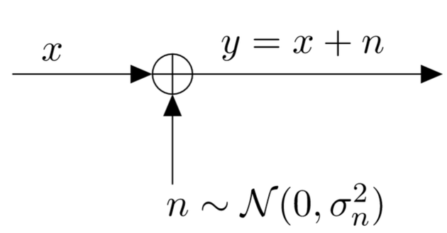
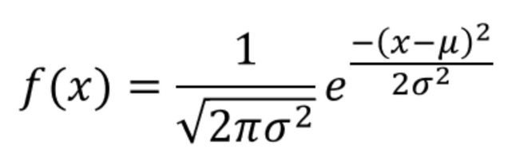
CT PROJECT | GROUP 25
PAGE 21
AWGN (ADDITIVE WHITE GAUSSIAN NOISE)
Additive: Noise is added to the signal, not multiplied or altered structurally.
White: Power is uniformly distributed across all frequencies — like white light contains all colors.
Gaussian: The noise amplitude follows a Gaussian (normal) distribution with Mean = 0 and Variance = σ²
Therefore, The received signal y(t) is: y(t)=x(t)+n(t)
where:
x(t) = Transmitted signal
n(t) = Gaussian noise,
y(t) = Received signal
The BPSK symbols are transmitted through an AWGN channel, which mimics the transmission in the real world, where there is no interference and the channel is linear and time-invariant.

Slide 22
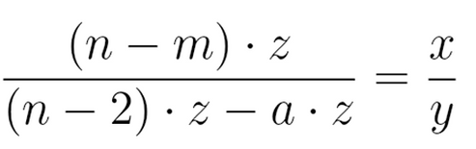
CT PROJECT | GROUP 25
PAGE 22
CodeRate Matching
Rate matching is used in LDPC codes to adjust the code rate to match the desired transmission rate.
For a base matrix of size m × n and expansion factor z, the possible length of the codeword is nz.
Out of these nz bits, the first 2z bits are punctured, leaving (n−2)·z bits available.
To achieve a code rate of x/y,
a·z bits are punctured from the available (n−2)·z bits.
We can evaluate the value of a from the given equation.
The number of message bits is calculated as (n−m)·z.
The H matrix size is determined by the number of parity bits and columns (calculated number + 2).

Slide 23
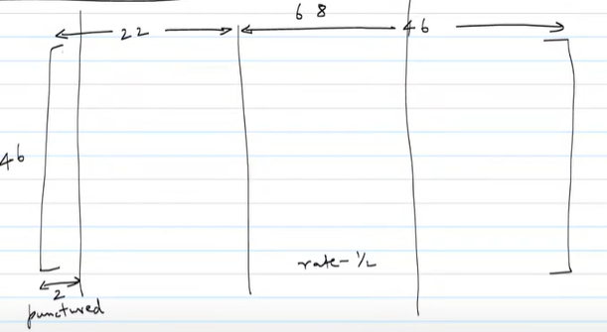
CT PROJECT | GROUP 25
PAGE 23
Code Rate Matching
For Example,
If we take 46x68 matrix,
22z bits are information bits
68z bits are possible codewords bits
first 2z bits are punctured
now if we select only the first 24 columns from 46 columns, we will transmit 20z + 24z bits = 44z bits
so rate = 22z / 44z = 1/2

Slide 24
DECODING

Slide 25
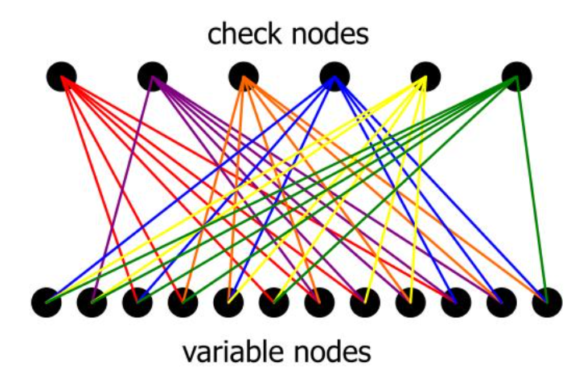
CT PROJECT | GROUP 25
PAGE 25
TANNER GRAPH
A Tanner graph is a bipartite graph used to represent LDPC (Low-Density Parity-Check) codes. they consist of two separate types of nodes:
Variable Nodes (VNs): represent individual bits of a codeword.
Check Nodes (CNs): These represent the parity-check equations (constraints).
In this representation, connections (edges) are drawn between variable nodes and check nodes based on the relationships defined in the parity-check matrix of a linear error-correcting code. An edge indicates that a particular bit is involved in a specific parity check.

Slide 26
CT PROJECT | GROUP 25
PAGE 26
TANNER GRAPH
From our MATLAB Code, we have implemented the Tanner graph using a message-passing matrix between CNs and VNs. The equation used is:
L = r .* H
r: Received bits (after demodulation).
H: Parity-check matrix.
L: Message-passing matrix between CNs and VNs.
This H matrix defines your Tanner Graph:
Each row of H is a Check Node (CN).
Each column of H is a Variable Node (VN).
If H(i,j) = 1, there's an edge between CN i and VN j.

Slide 27
HARD DECISION
DECODING

Slide 28
CT PROJECT | GROUP 25
PAGE 28
HARD DECODING
Hard decision decoding is a type of decoding technique used in digital communication systems where the receiver makes a firm decision about each received bit — either a 0 or a 1 — before decoding. It discards all signal strength information and just keeps the bit.
Why Need New Decision Scheme ?
Suppose we receive this analog signal:
[0.8, −0.3, 0.9, −0.1]
You apply a threshold (e.g., 0):
Values > 0 → 0
Values ≤ 0 → 1
So you get:
[0, 1, 0, 1]
It's used when you prioritize speed and simplicity over accuracy.
But it throws away reliability information i.e. the received noisy message, which is untilised in soft decoing

Slide 29
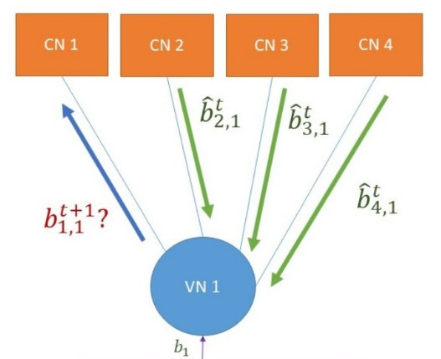
CT PROJECT | GROUP 25
PAGE 29
VN TO CN
Initially, the received bits from the channel are placed into their respective variable nodes (VNs).
As we begin the first iteration:
Each VN sends the bit it currently holds to all the check nodes (CNs) it is connected to.

Slide 30
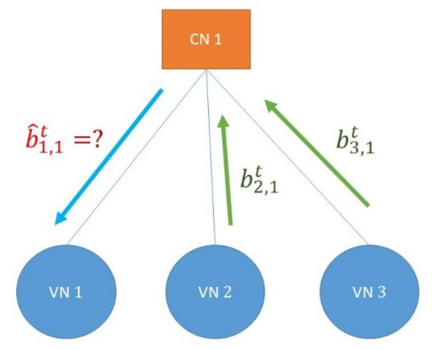
CT PROJECT | GROUP 25
PAGE 30
CN TO VN
At this point, every check node receives bits from all its connected variable nodes — the number of bits corresponds to the CN's degree.
Now, since each CN enforces a single parity-check (SPC) constraint, for every VN connected to it, the CN computes the XOR of all other incoming bits (excluding the one from that particular VN). This result is then sent back as a message to that VN.

Slide 31
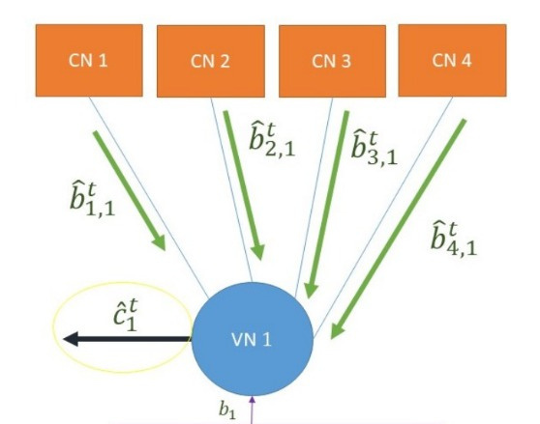
CT PROJECT | GROUP 25
PAGE 31
Last Step of Iteration
Next, each VN gathers responses from all the check nodes it’s linked to — the count of messages equals the VN’s degree.
In the next phase, each VN performs a majority vote among the bits received from CNs, along with the original bit it was initialized with. The result of this vote becomes the VN’s new value. Also, in the case of a tie (equal number of 1’s and 0’s),we are assuming that the variable node decides its value as 0.
This iterative process continues either until a maximum number of iterations is reached, or until no further changes occur in current decoded codeword.

Slide 32
SOFT DECISION
DECODING

Slide 33
CT PROJECT | GROUP 25
PAGE 33
SOFT DECISION DECODING
Soft decoding is a technique used in digital communications to improve the accuracy of received data by considering the confidence level of each bit, rather than making a simple binary decision
Why Need New Decision Scheme ?
In traditional hard decision decoding, the receiver interprets incoming signals strictly as binary values '0' or '1' based on a fixed threshold. This approach doesn't account for the reliability of the received bits.
Imagine receiving a signal that's supposed to represent a binary '0', but due to noise, the signal's amplitude is slightly off. In hard decoding, if the amplitude crosses the threshold, it might be incorrectly interpreted as a '1'. Soft decoding, however, would assess the amplitude's proximity to the expected value and might still correctly interpret it as a '0' based on its confidence level.
Soft decoding, on the other hand, assigns a confidence level to each bit, often represented as a Log-Likelihood Ratio (LLR).

Slide 34
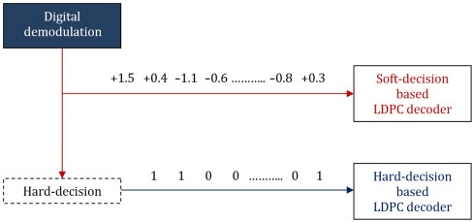
CT PROJECT | GROUP 25
PAGE 34
SOFT DECISION DECODING - MIN SUM ALGORITHM
The Min-Sum Algorithm works on the Tanner graph by passing messages between variable and check nodes. To reduce computational complexity, it replaces the mathematically heavy operations—like hyperbolic tangent functions—with a much simpler rule: it takes the minimum of the absolute incoming messages and multiplies their signs.

Slide 35
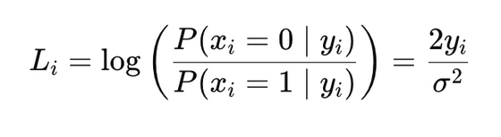
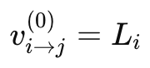
CT PROJECT | GROUP 25
PAGE 35
SOFT DECISION DECODING - MIN SUM ALGORITHM
Algorithmic Approach
INITIALIZATION
Each received bit yi​ from the channel (e.g., BPSK over AWGN) is converted into a channel LLR:
Where:
yi : Received value (e.g., +1 or −1 with noise)
σ2 : Noise variance
Then initialize
This is the message sent from variable node i to check node j in the first iteration.

Slide 36
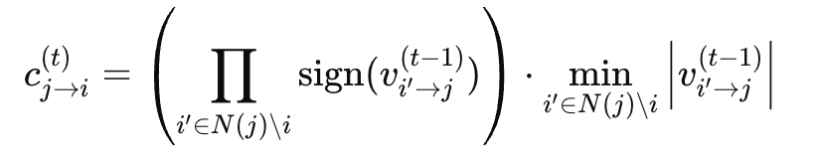
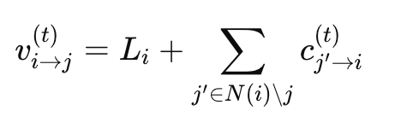
CT PROJECT | GROUP 25
PAGE 36
SOFT DECISION DECODING - MIN SUM ALGORITHM
Algorithmic Approach
CHECK NODE UPDATE
VARIABLE NODE UPDATE
Each check node j computes a message to each variable node i∈N(j) using the messages received from all other VNs i′∈N(j)\i
Each variable node i updates the message to each check node j∈N(i) :

Slide 37
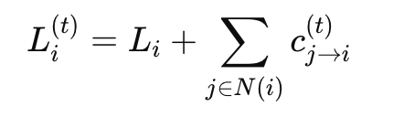
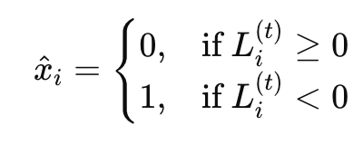
CT PROJECT | GROUP 25
PAGE 37
SOFT DECISION DECODING - MIN SUM ALGORITHM
Algorithmic Approach
A POSTERIORI LLR CALCULATION
At each variable node i, compute the updated LLR estimate for the bit:
This value is used for making a hard decoding

Slide 38
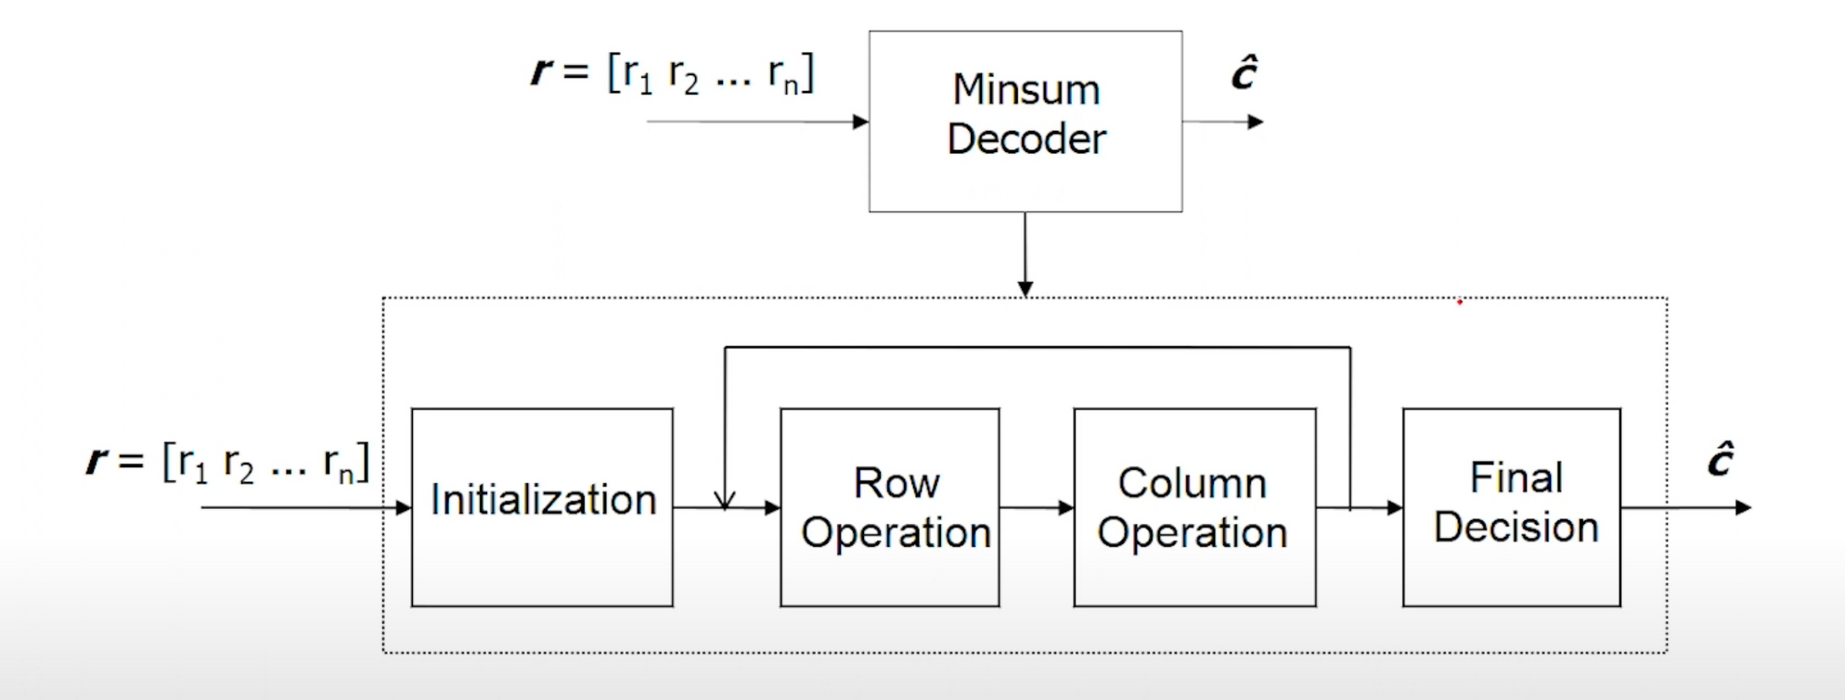
CT PROJECT | GROUP 25
PAGE 38
SOFT DECISION DECODING - MIN SUM ALGORITHM

Slide 39
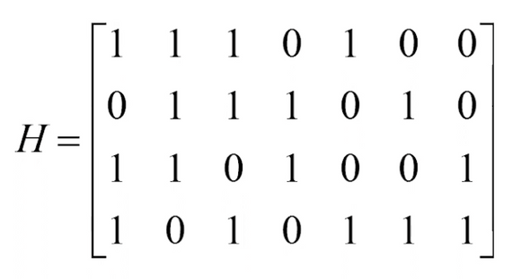
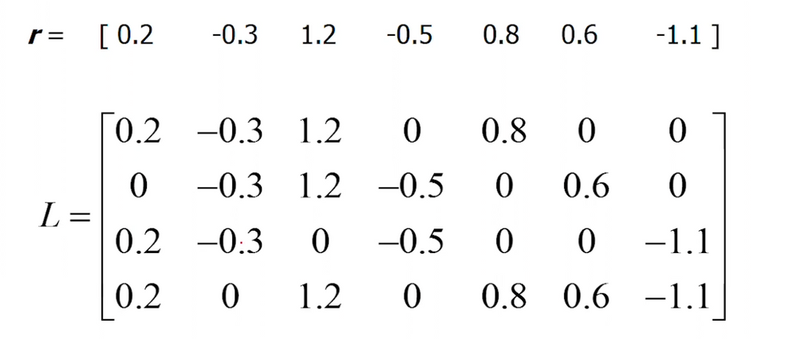
CT PROJECT | GROUP 25
PAGE 39
SOFT DECISION DECODING - MIN SUM ALGORITHM
EXAMPLE
L : Storage Matrix - Sparse Matrix of same dimension as Parity Check Matrix
Consider the given H Matrix
Initialization Step

Slide 40
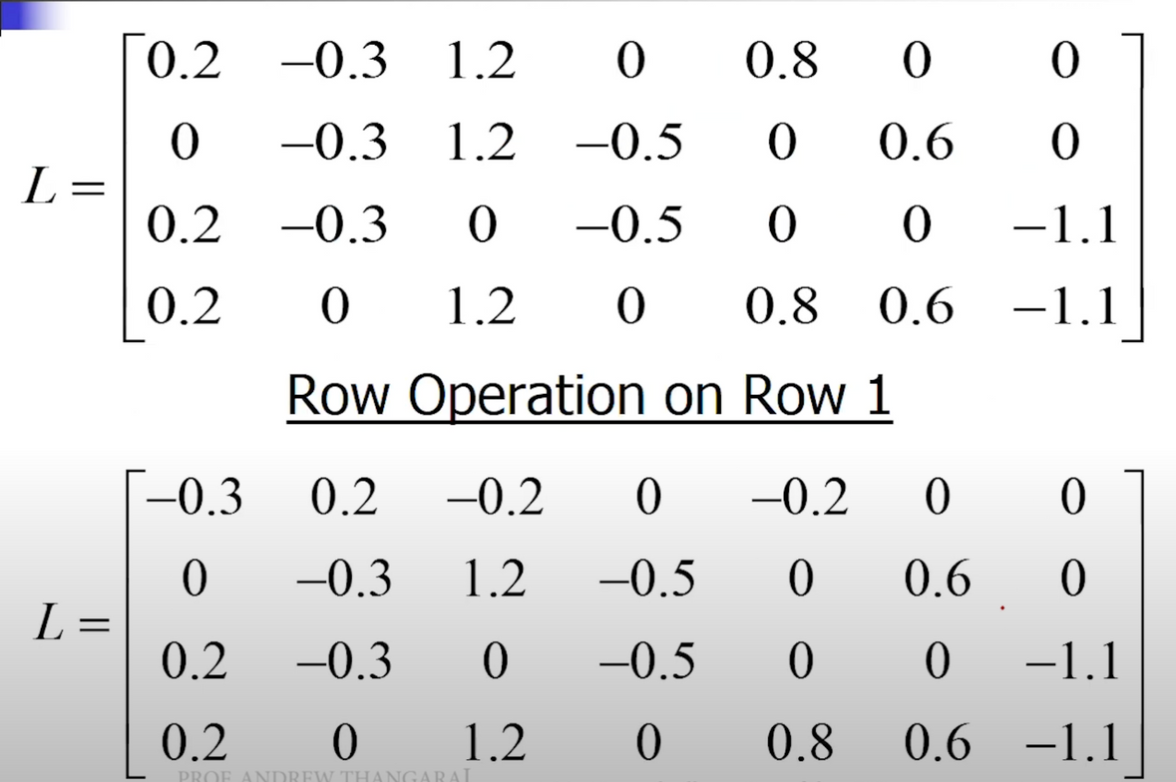
CT PROJECT | GROUP 25
PAGE 40
SOFT DECISION DECODING - MIN SUM ALGORITHM
EXAMPLE
Row Operations :
Magnitude :
Min1 = Minimum absolute value of all nonzero entries
in a row.
Min2 = Next higher absolute value
Set the magnitude of all values except the minimum value as Min1.
Set magnitude of minimum value as Min2
Sign :
Parity = Product of signs of entries in a row.
New sign of entry = (Old Sign)*(Parity)

Slide 41
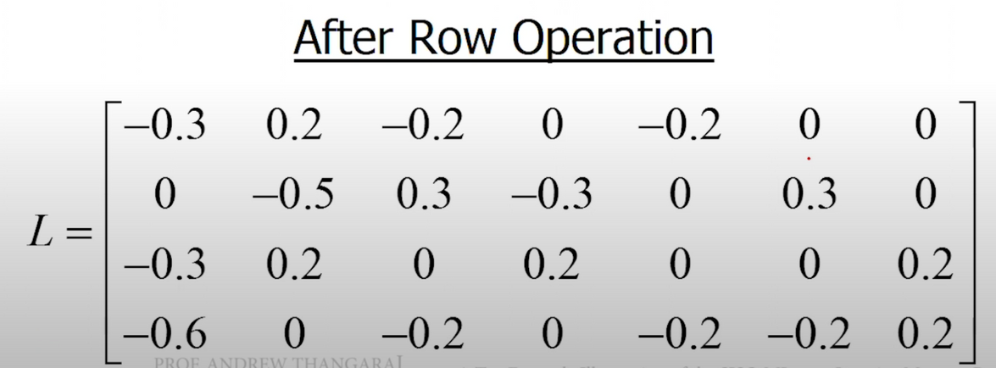
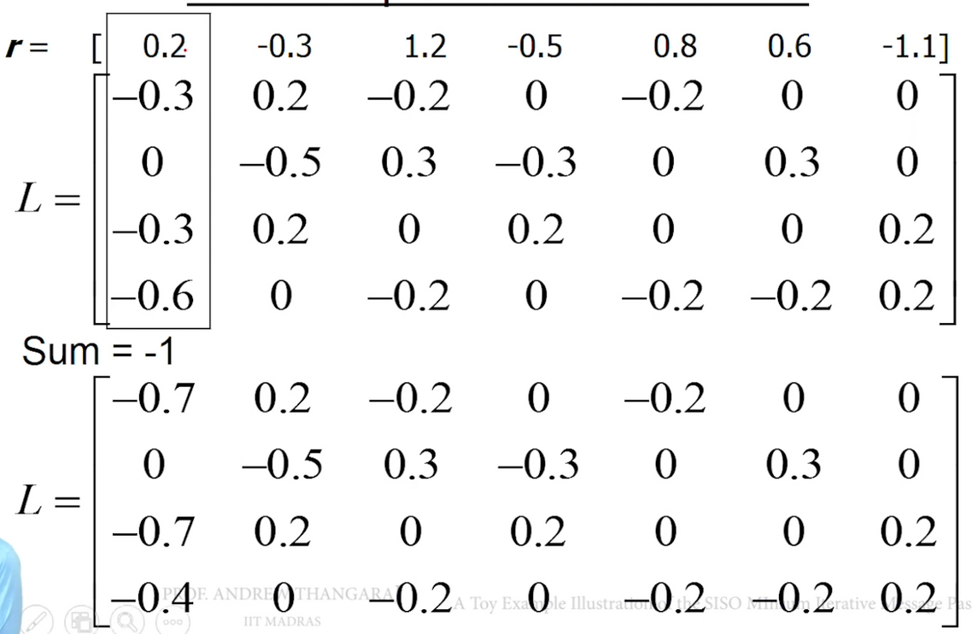
CT PROJECT | GROUP 25
PAGE 41
SOFT DECISION DECODING - MIN SUM ALGORITHM
EXAMPLE
Column Operations :
For each column
New Values:
Sumj = rj + sum of all entries in column j
New Entry = Sum - (Old Entry)

Slide 42
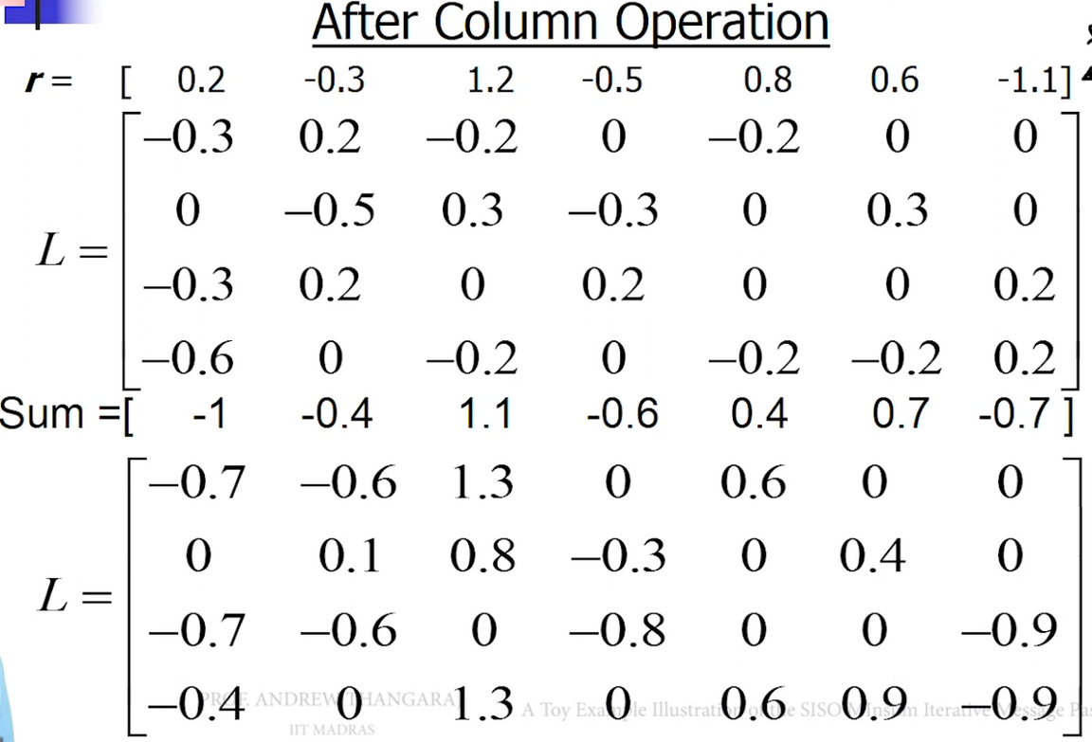
CT PROJECT | GROUP 25
PAGE 42
SOFT DECISION DECODING - MIN SUM ALGORITHM
EXAMPLE

Slide 43
GRAPHS OF MATRIX NR_2_6_52

Slide 44
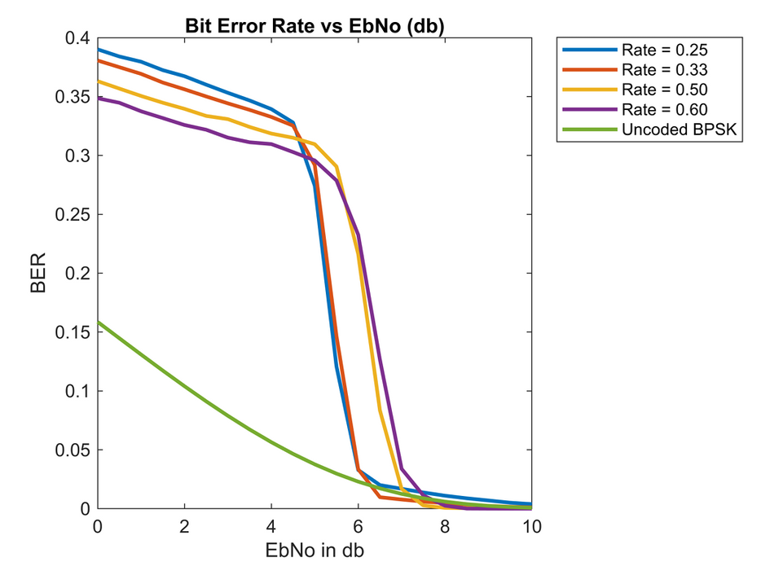
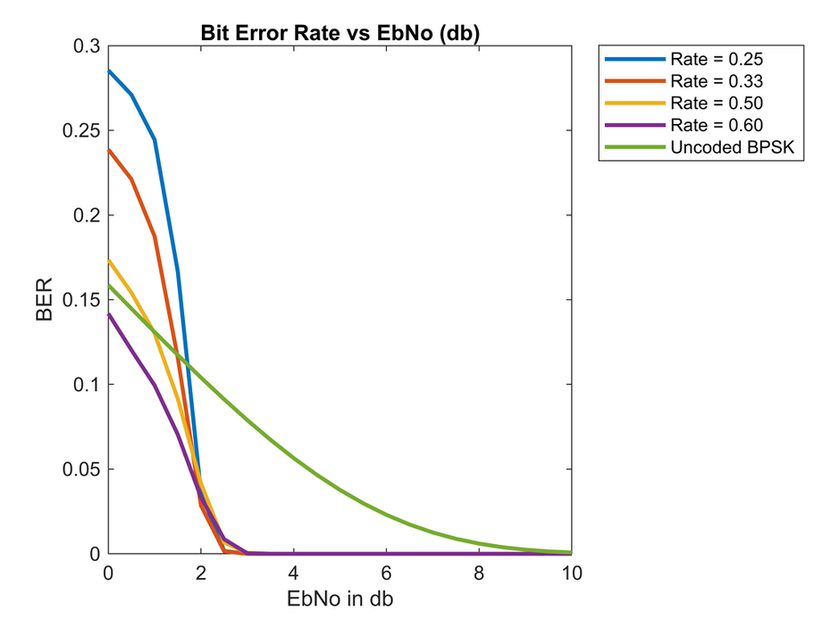

CT PROJECT | GROUP 25
PAGE 44
Bit Error Rate Vs Signal to Noise Ratio(dB)
HARD DECISION DECODING
SOFT DECISION DECODING
Here, we can observe that for Eb/No=5-7 BER drops exponentially, thus after this decoding becomes highly successful.
Here, we can observe that for Eb/No=1-2 BER drops exponentially, thus after this decoding becomes highly successful.

Slide 45
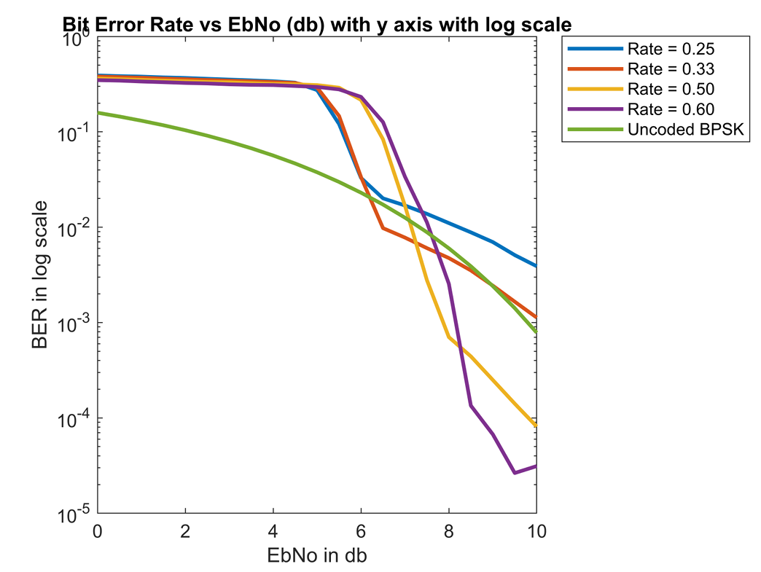
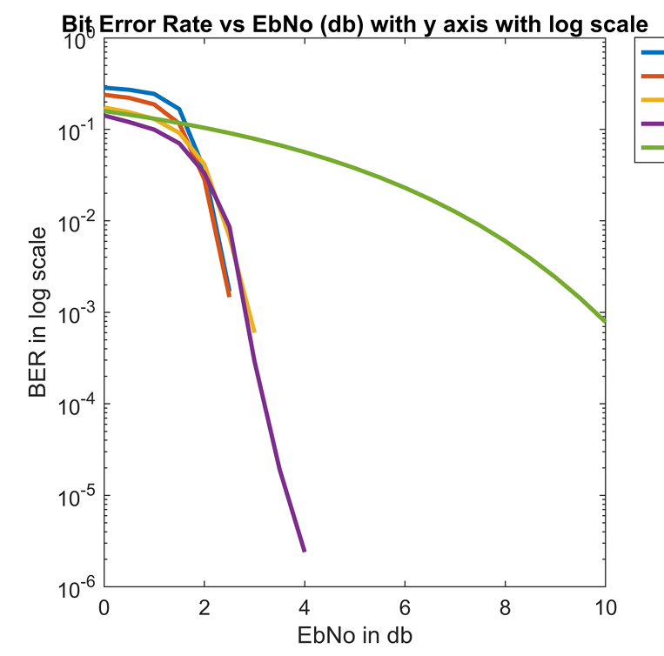

CT PROJECT | GROUP 25
PAGE 45
Bit Error Rate Vs Signal to Noise Ratio(dB) In Log Scale
HARD DECISION DECODING
SOFT DECISION DECODING

Slide 46
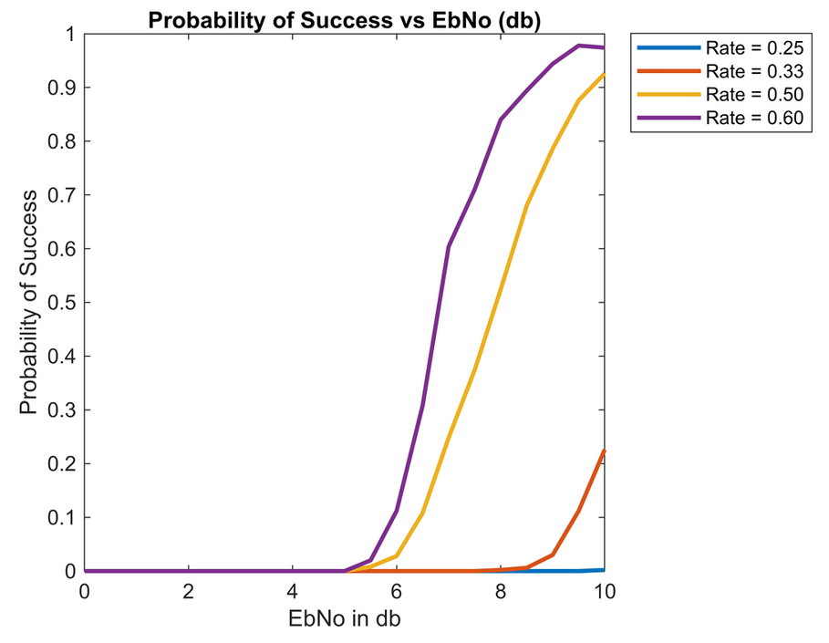
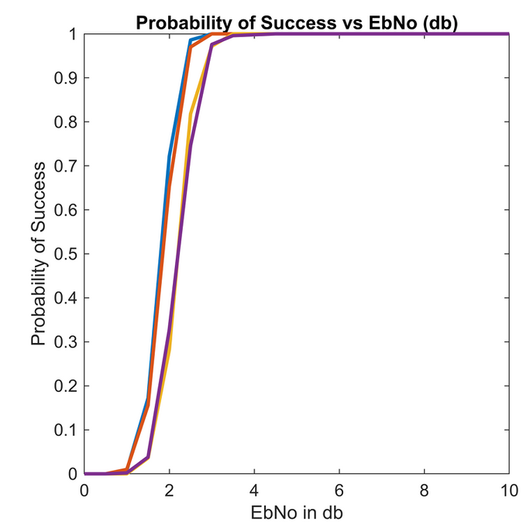

CT PROJECT | GROUP 25
PAGE 46
Probability of Success Vs Signal to Noise Ratio(dB)
HARD DECISION DECODING
SOFT DECISION DECODING
As the Code Rate decreases, higher value of Eb/N0 is required to achieve greater probability of Success for Hard Decision Decoding.
In Soft Decision Decoding, for any Eb/N0 above 3, Probability of Success is almost 100%.

Slide 47
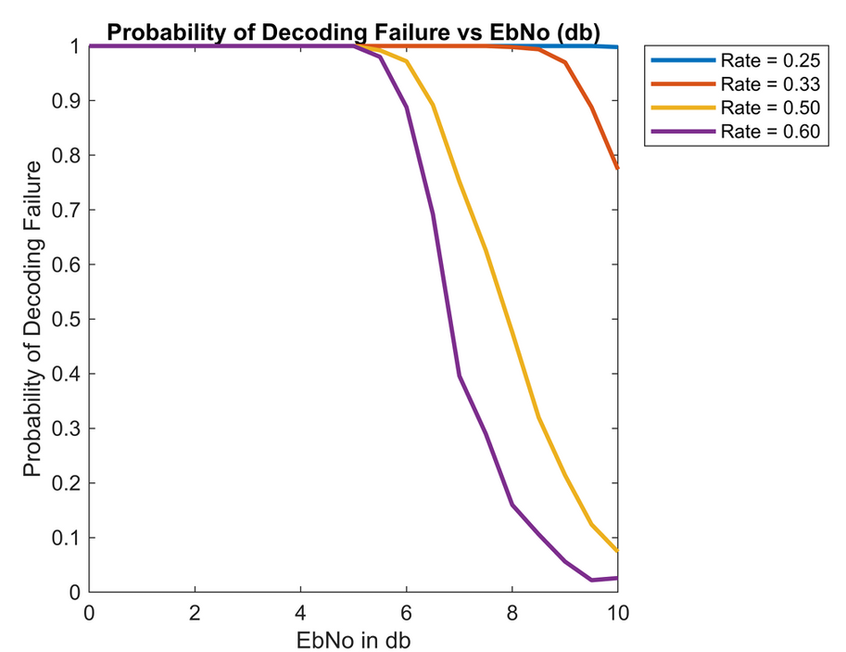
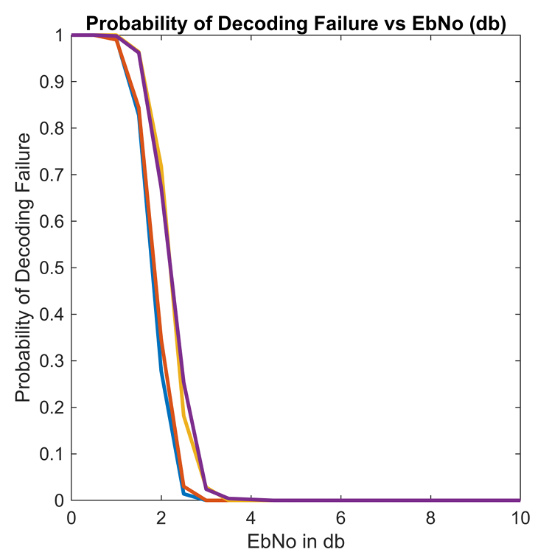
CT PROJECT | GROUP 25
PAGE 47
Probability of Decoding Failure Vs Signal to Noise Ratio(dB)
HARD DECISION DECODING
SOFT DECISION DECODING

Slide 48
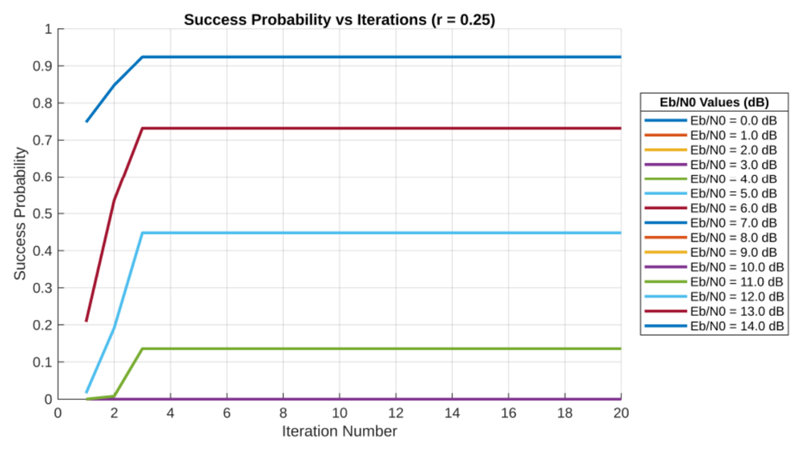
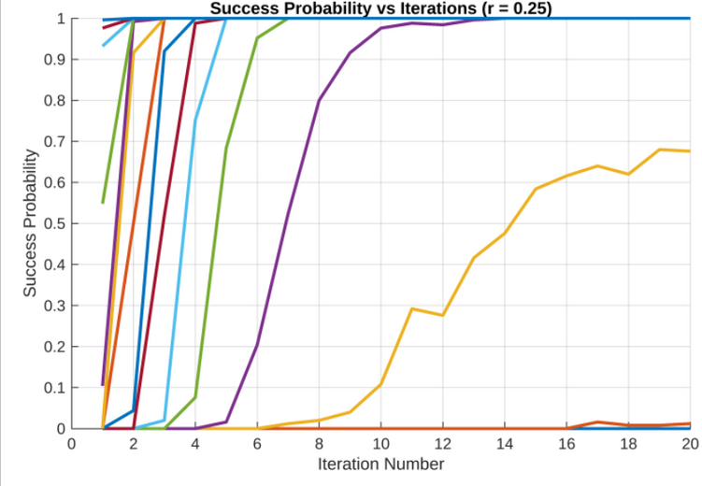
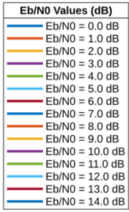
CT PROJECT | GROUP 25
PAGE 48
Probability of Success Vs No. of Iterations
CODE RATE = 1/4
HARD DECISION DECODING
SOFT DECISION DECODING

Slide 49
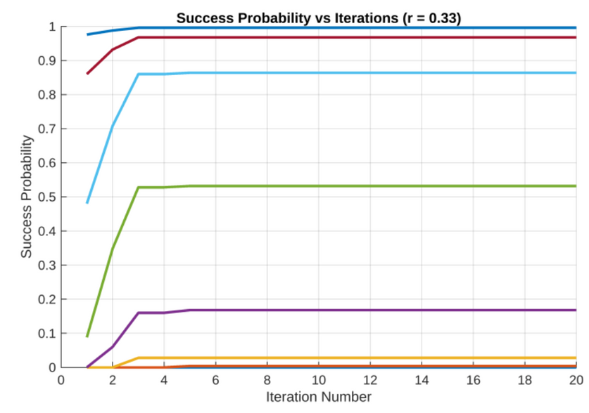
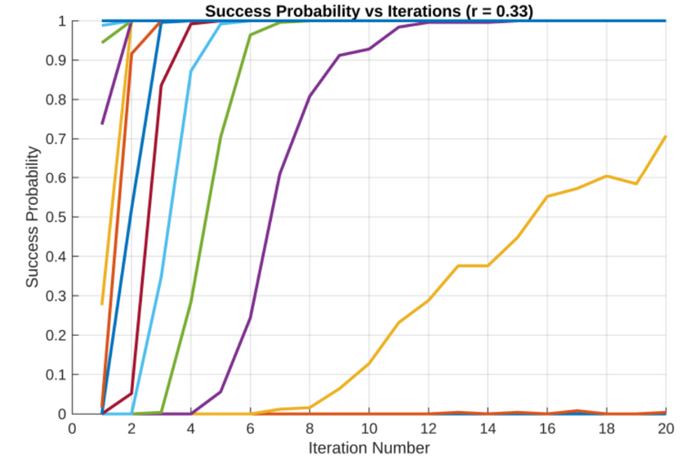
CT PROJECT | GROUP 25
PAGE 49
Probability of Success Vs No. of Iterations
CODE RATE = 1/3
HARD DECISION DECODING
SOFT DECISION DECODING

Slide 50
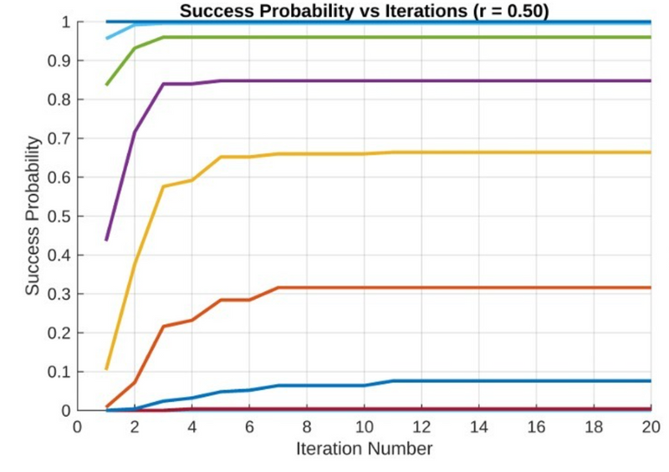
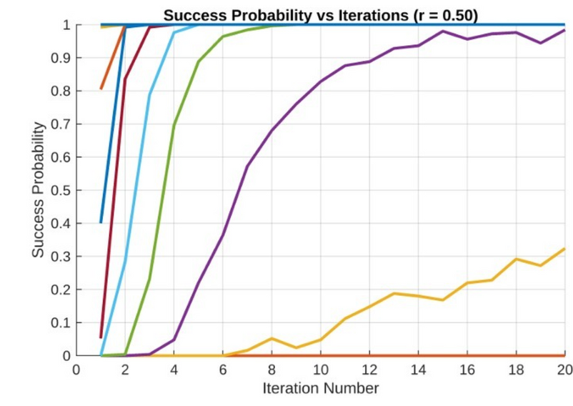
CT PROJECT | GROUP 25
PAGE 50
Probability of Success Vs No. of Iterations
CODE RATE = 1/2
HARD DECISION DECODING
SOFT DECISION DECODING

Slide 51
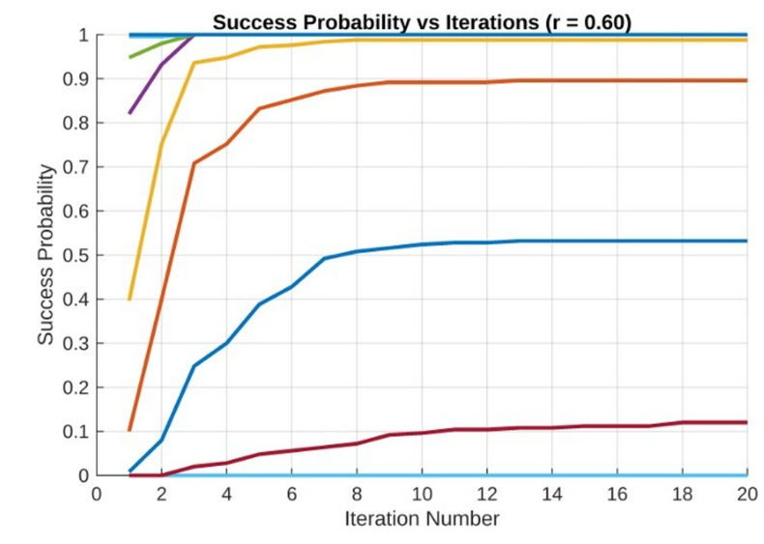
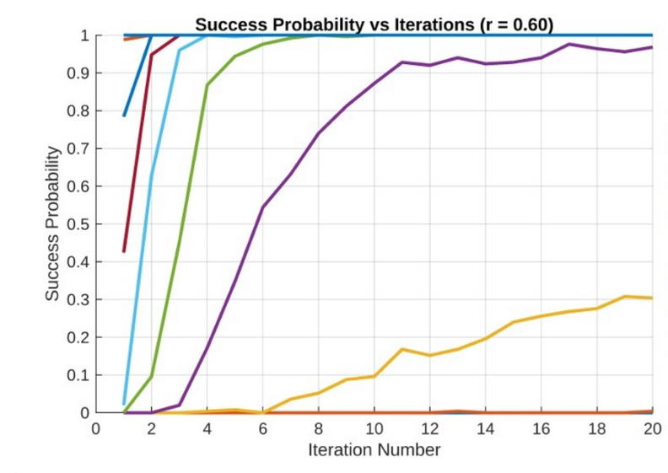
CT PROJECT | GROUP 25
PAGE 51
Probability of Success Vs No. of Iterations
CODE RATE = 3/5
HARD DECISION DECODING
SOFT DECISION DECODING

Slide 52
GRAPHS OF MATRIX NR_1_5_352
*NSim = 1

Slide 53
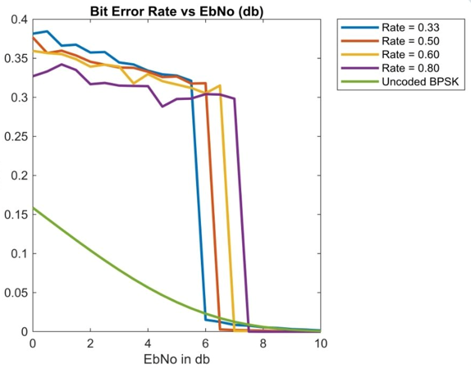
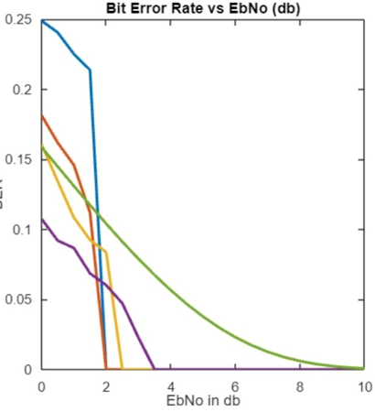
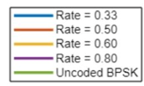
CT PROJECT | GROUP 25
PAGE 53
Bit Error Rate Vs Signal to Noise Ratio(dB)
HARD DECISION DECODING
SOFT DECISION DECODING

Slide 54
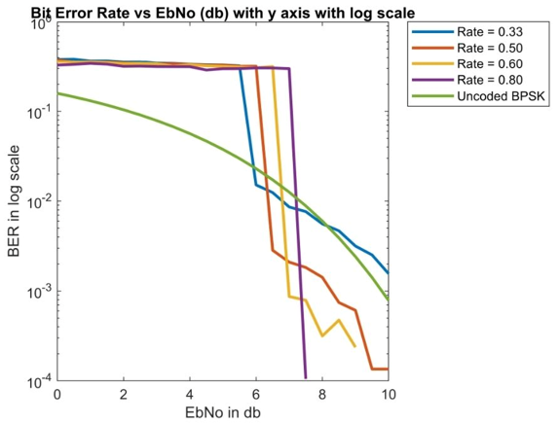

CT PROJECT | GROUP 25
PAGE 54
Bit Error Rate Vs Signal to Noise Ratio(dB) In Log Scale
HARD DECISION DECODING
SOFT DECISION DECODING

Slide 55


CT PROJECT | GROUP 25
PAGE 55
Probability of Success Vs Signal to Noise Ratio(dB)
HARD DECISION DECODING
SOFT DECISION DECODING

Slide 56


CT PROJECT | GROUP 25
PAGE 56
Probability of Decoding Failure Vs Signal to Noise Ratio(dB)
HARD DECISION DECODING
SOFT DECISION DECODING

Slide 57
CT PROJECT | GROUP 25
PAGE 57
BIBLIOGRAPHY
NPTEL-NOC IITM Course : LDPC and Polar Codes in 5G Standard by Prof. Andrew Thangraj
An Introduction to Low-Density Parity-Check Codes by Paul H. Siegel, Electrical and Computer Engineering University of California, San Diego
Introduction to Low-Density Parity Check Codes by Brian Kurkoski
CT-216 Introduction to Communication Systems Lecture Slides by Prof. Yash Vasavada, DAIICT Winter 2025
Different references from ShareTechNote Handbook on 5G

Slide 58
THANK YOU

